Slide 1

Lecture 2 Conditional Statements (Control Structure)
Computer Engineering/Basic Computer Engineering

Slide 2
Control Structure
Control Structure
Selection Structure
Repetition Structure
If-else
nested if
while
for
do-while

Slide 3
Selection Structure

Slide 4


Conditional Statements
Used to make decisions based on the conditions.
There are two types of conditions :
Decision making condition statement
Selection condition statement

Slide 5
Conditional Statements
Conditional statements execute sequentially when there is no condition around the statements.
If you put some condition for a block of statements, the execution flow may change based on the result evaluated by the condition.
This process is called decision making in ‘C.’

Slide 6
Conditional Statements
Decision making structures require that the programmer specifies one or more conditions to be evaluated or tested by the program, along with a statement or statements to be executed if the condition is determined to be true, and optionally, other statements to be executed if the condition is determined to be false. Show below is the general form of a typical decision making structure found in most of the programming languages −

Slide 7
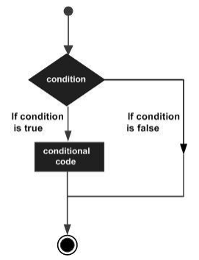
Conditional Statements
Show below is the general form of a typical decision making structure found in most of the programming languages.

Slide 8
if
if, else
Switch
An if statement consists of a Boolean expression/test expression /condition followed by one or more statements.
An if statement can be followed by an optional else statement, which executes when the Boolean expression/test expression/condition is false.
A switch statement allows a variable to be tested for equality against a list of values.

Slide 9
if statements
An if statement consists of a Boolean expression followed by one or more statements.
The syntax of the if statement in C programming is:
if (test expression/condition)
{
code //statements to be executed if the condition is true
}

Slide 10
if statements
if (test expression/condition)
{
code //statements to be executed if the condition is true
}
The if statement evaluates the test expression inside the parenthesis ().
If the test expression is evaluated to true, statements inside the body of if are executed.
If the test expression is evaluated to false, statements inside the body of if are not executed.

Slide 11
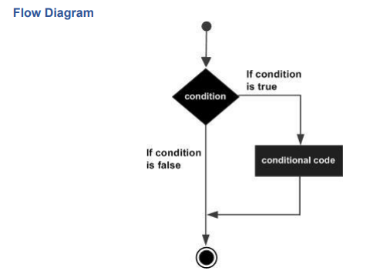
if statements

Slide 12
if statements
#include
int main ()
{
int a = 10; /* variable declaration */
if(a < 20 ) /* check the condition using if statement */
{
printf("a is less than 20\n" ); /* if condition is true then print the following */
}
printf("value of a is : %d\n", a);
return 0;
}
Output:
a is less than 20
Value of a is : 10

Slide 13
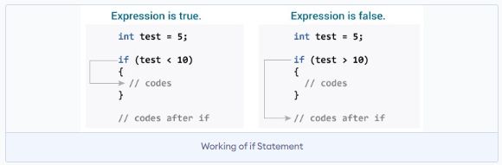
if statements
If the test expression is evaluated to true, statements inside the body of if are executed. | If the test expression is evaluated to false, statements inside the body of if are not executed.

Slide 14

if statements
What is the output ?
// Program to display a number if it is negative
#include <stdio.h>
int main()
{
int number;
printf("Enter an integer: ");
scanf("%d", &number);
if (number < 0) //check condition using if statements
{
printf("You entered %d\n", number);
}
return 0;
}

Slide 15
if….else statements
An if statement can be followed by an optional else statement, which executes when the test expression/condition is false.
The syntax of the if statement in C programming is:
if (test expression)
{
code // run code if test expression is true
}
else
{
code // run code if test expression is false
}

Slide 16
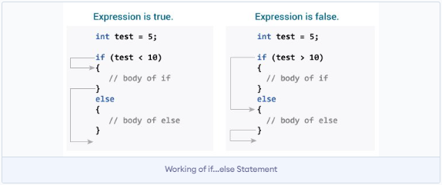
if….else statements
If the test expression is evaluated to true, statements inside the body of if are executed. statements inside the body of else are skipped from execution. | If the test expression is evaluated to false, statements inside the body of else are executed. statements inside the body of if are skipped from execution.

Slide 17
if….else statements
// Program to display a number if it is negative
#include <stdio.h>
int main()
{
int number;
printf("Enter an integer: ");
scanf("%d", &number);
if (number < 0) //check condition using if statements
{
printf("You entered %d\n", number);
}
else
{
printf(“Invalid Number”);
}
return 0;
}
What is the output ?

Slide 18
if….else statements
// Check whether an integer is odd or even
#include <stdio.h>
int main()
{
int number;
printf("Enter an integer: ");
scanf("%d", &number);
if (number%2 == 0) // True if the remainder is 0
{
printf("%d is an even integer.",number);
}
else
{
printf("%d is an odd integer.",number);
}
return 0;
}
What is the output ?

Slide 19
if….else ladder
The if...else statement executes two different codes depending upon whether the test expression is true or false. Sometimes, a choice has to be made from more than 2 possibilities.
The if...else ladder allows you to check between multiple test expressions and execute different statements.

Slide 20
if….else ladder
if (test expression1)
{
// statement(s)
}
else if(test expression2)
{
// statement(s)
}
else if (test expression3)
{
// statement(s)
}
.
.
Else
{
// statement(s)
}

Slide 21
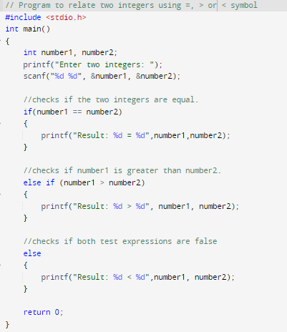
if….else ladder

Slide 22
nested if statements
It is always legal in C programming to nest if-else statements, which means you can use one if or else if statement inside another if or else if statement(s).
Syntax
The syntax for a nested if statement is as follows −
if (condition 1)
{
/* Executes when the condition 1 is true */
if (condition 2)
{
/* Executes when the condition 2 is true */
}
}

Slide 23
nested if statements
#include <stdio.h>
int main ()
{
int a = 100; /* local variable definition */
int b = 200;
if( a == 100 ) /* check the boolean condition */
{
if( b == 200 ) /* if condition is true then check the following */
{
printf("Value of a is 100 and b is 200\n" ); /* if condition is true then print*/
}
}
printf("Exact value of a is : %d\n", a );
printf("Exact value of b is : %d\n", b );
return 0;
}

Slide 24
switch statement
The switch statement allows us to execute one code block among many alternatives. You can do the same thing with the if...else..if ladder. However, the syntax of the switch statement is much easier to read and write.

Slide 25
switch statement
switch (expression)
​{
case constant1:
// statements
break;
case constant2:
// statements
break;
.
.
default:
// default statements
}
How does the switch statement work?
The expression is evaluated once and compared with the values of each case label.
If there is a match, the corresponding statements after the matching label are executed. For example, if the value of the expression is equal to constant2, statements after case constant2: are executed until break is encountered.
If there is no match, the default statements are executed.

Slide 26
switch statement
The following rules apply to a switch statement
The case constant for a case must be the same data type as the variable in the switch, and it must be a constant or a literal.
When the variable being switched on is equal to a case, the statements following that case will execute until a break statement is reached.
When a break statement is reached, the switch terminates, and the flow of control jumps to the next line following the switch statement.
switch (expression)
​{
case constant1:
// statements
break;
case constant2:
// statements
break;
.
.
default:
// default statements
}

Slide 27
switch statement
switch (expression)
​{
case constant1:
// statements
break;
case constant 2
case constant3:
// statements
break;
.
.
default:
// default statements
}
The following rules apply to a switch statement
Not every case needs to contain a break. If no break appears, the flow of control will fall through to subsequent cases until a break is reached.
A switch statement can have an optional default case, which must appear at the end of the switch. The default case can be used for performing a task when none of the cases is true. No break is needed in the default case.

Slide 28
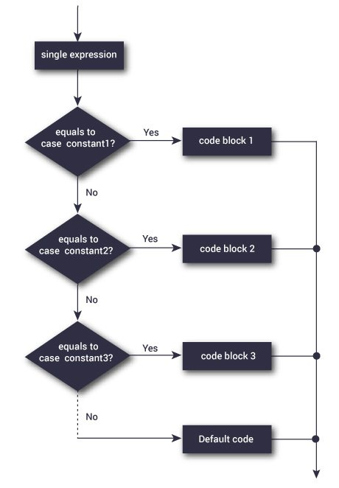
switch statement flowchart

Slide 29
switch statement example
#include <stdio.h>
int main ()
{
char grade = 'B’;
switch(grade)
{
case 'A’ :
printf("Excellent!\n" );
break;
case 'B' :
case 'C' :
printf("Well done\n" );
break;
case 'D' :
printf("You passed\n" );
break;
case 'F' :
printf("Better try again\n" );
break;
default :
printf("Invalid grade\n" );
}
printf("Your grade is %c\n", grade );
return 0;
}

Slide 30
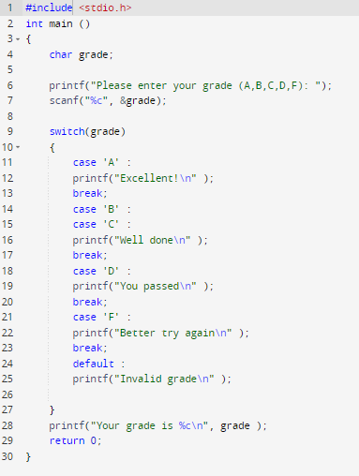
switch statement example
What is the output ?

Slide 31
nested switch statement
It is possible to have a switch as a part of the statement sequence of an outer switch. Even if the case constants of the inner and outer switch contain common values, no conflicts will arise.

Slide 32
nested switch statement
Syntax : The syntax for a nested switch statement is as follows −
switch(ch1)
{
case 'A’:
printf("This A is part of outer switch" );
switch(ch2)
{
case 'A’:
printf("This A is part of inner switch" );
break;
case 'B': /* case code */
}
break;
case 'B': /* case code */
}

Slide 33
nested switch statement example
#include <stdio.h>
int main ()
{
int a = 100; /* local variable definition */
int b = 200;
switch(a)
{
case 100:
printf("This is part of outer switch\n", a );
switch(b)
{
case 200:
printf("This is part of inner switch\n", a );
}
}
printf("Exact value of a is : %d\n", a );
printf("Exact value of b is : %d\n", b );
return 0;
}
Output:
This is part of outer switch
This is part of inner switch
Exact value of a is : 100
Exact value of b is : 200

Slide 34
Recap
What have you learned in the previous class ?

Slide 35
Repetition Structure (Loop)

Slide 36
Repetition/Loops
A loop statement allows us to execute a statement or group of statements multiple times. Given below is the general form of a loop statement in most of the programming languages.

Slide 37
Repetition/Loops
A loop statement allows us to execute a statement or group of statements multiple times.
C programming has three types of loops.
for loop
while loop
do...while loop

Slide 38
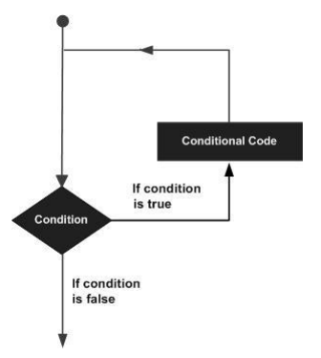
Repetition / Loops

Slide 39
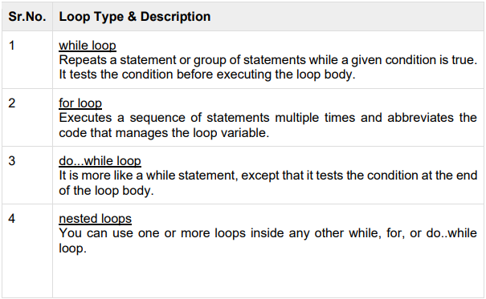
Repetition / Loops
C programming language provides the following types of loops to handle looping requirements.

Slide 40
for loop
A for loop is a repetition control structure that allows you to efficiently write a loop that needs to execute a specific number of times.
The syntax of the for loop is:
for (initialization Statement; test Expression; update Statement/increment)
{
// statements inside the body of loop
}

Slide 41
for loop
How for loops works ?
The initialization statement is executed only once.
Then, the test expression is evaluated. If the test expression is evaluated to false, the for loop is terminated.
However, if the test expression is evaluated to true, statements inside the body of the for loop are executed, and the update expression is updated.
Again, the test expression is evaluated.
for (initialization Statement; test Expression; update Statement)
{
// statements inside the body of loop
}

Slide 42
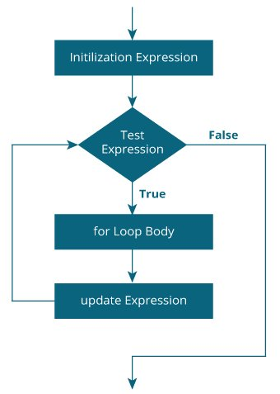
for loop flowchart
This process goes on until the test expression is false.
When the test expression is false, the loop terminates.

Slide 43
for loop example
#include <stdio.h>
int main ()
{
int a;
for (a = 10; a <= 20; a = a + 1 )
{
printf("value of a: %d\n", a);
}
return 0;
}
What is the output ?

Slide 44
while loop
A while loop in C programming repeatedly executes a target statement as long as a given condition is true.
Syntax
The syntax of a while loop in C programming language is:
while(condition)
{
statement(s);
}

Slide 45
while loop
How while loop works?
The while loop evaluates the condition inside the parentheses ().
If condition is true, statements inside the body of while loop are executed. Then, condition is evaluated again.
The process goes on until condition is evaluated false.
If condition is false, the loop terminates (ends).

Slide 46
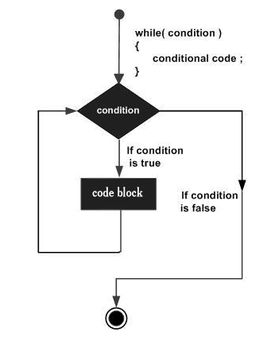
while loop flowchart
Here, the key point to note is that a while loop might not execute at all. When the condition is tested and the result is false, the loop body will be skipped and the first statement after the while loop will be executed.

Slide 47
while loop example
// Print numbers from 1 to 5
#include <stdio.h>
int main()
{
int i = 1;
while (i <= 5)
{
printf("%d\n", i);
++i;
}
return 0;
}
We have initialized i to 1
When i = 1, the test expression i <= 5 is true. Hence, the body of the while loop is executed. This prints 1 on the screen and the value of i is increased to 2.
What is the output ?

Slide 48
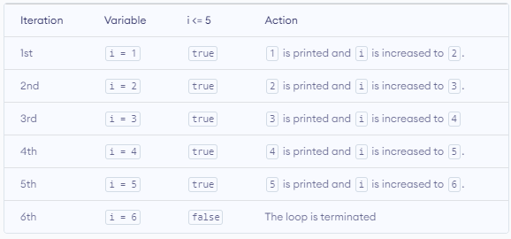
while loop example

Slide 49
while loop example
#include <stdio.h>
int main ()
{
int a = 10; /* local variable definition */
while(a < 20 ) /* while loop execution */
{
printf("value of a: %d\n", a); a++;
}
return 0;
}
What is the output ?

Slide 50
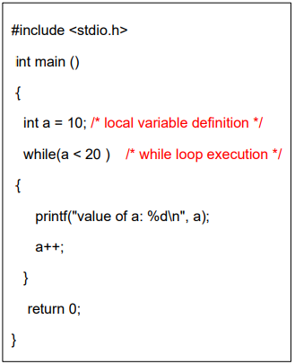
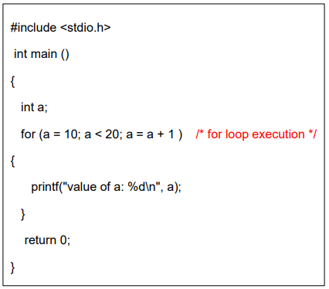
for vs while

Slide 51
do…while loop
Unlike for and while loops, which test the loop condition at the top of the loop, the do...while loop in C programming checks its condition at the bottom of the loop. A do...while loop is similar to a while loop, except the fact that it is guaranteed to execute at least one time.
Syntax
The syntax of a do…while loop in C programming language is:
do
{
// the body of the loop
}
while (testExpression);

Slide 52
do…while loop
do
{
// the body of the loop
}
while (testExpression);
Notice that the conditional expression appears at the end of the loop, so the statement(s) in the loop executes once before the condition is tested.
If the condition is true, the flow of control jumps back up to do, and the statement(s) in the loop executes again. This process repeats until the given condition becomes false.

Slide 53
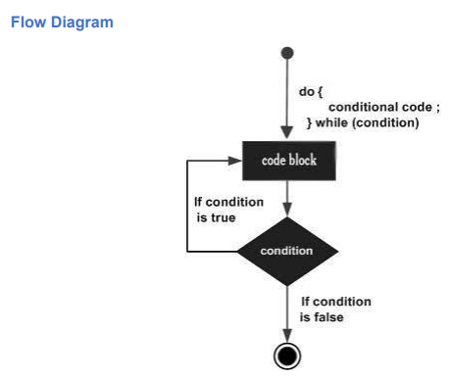
do…while loop flowchart

Slide 54
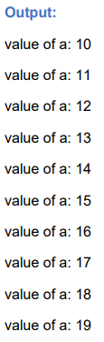
do…while loop example
#include <stdio.h>
int main ()
{
int a = 10; /* local variable definition */
do /* do loop execution */
{
printf("value of a: %d\n", a); a = a + 1;
}
while( a < 20 );
return 0;
}

Slide 55
do…while loop example
// Program to add numbers until the user enters zero
#include <stdio.h>
int main()
{
double number, sum = 0;
do
{
printf("Enter a number: ");
scanf("%1f", &number);
sum += number;
}
while(number != 0.0);
printf("Sum = %.21f",sum);
return 0;
}
What is the output ?

Slide 56
do…while loop example
// Program to add numbers until the user enters zero
#include <stdio.h>
int main()
{
double number, sum = 0;
do
{
printf("Enter a number: ");
scanf("%1f", &number);
sum += number;
}
while(number != 0.0);
printf("Sum = %.21f",sum);
return 0;
}
Output
Enter a number: 1.5
Enter a number: 2.4
Enter a number: -3.4
Enter a number: 4.2
Enter a number: 0
Sum = 4.70

Slide 57
do…while loop explanation
Here, we have used a do...while loop to prompt the user to enter a number. The loop works as long as the input number is not 0.
{
double number, sum = 0;
do
{
printf("Enter a number: ");
scanf("%1f", &number);
sum += number;
}
while(number != 0.0);
printf("Sum = %.21f",sum);
return 0;
}
The do...while loop executes at least once i.e. the first iteration runs without checking the condition. The condition is checked only after the first iteration has been executed.
So, if the first input is a non-zero number, that number is added to the sum variable and the loop continues to the next iteration. This process is repeated until the user enters 0.
But if the first input is 0, there will be no second iteration of the loop and sum becomes 0.0.
Outside the loop, we print the value of sum.

Slide 58
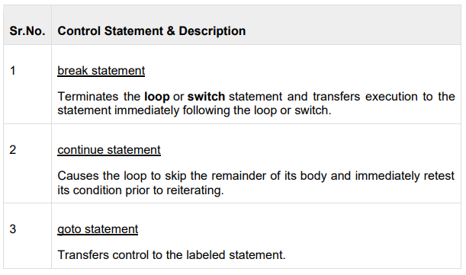
Loop control statements
Loop control statements change execution from its normal sequence. When execution leaves a scope, all automatic objects that were created in that scope are destroyed.
C supports the following control statements.

Slide 59
Break statements
The break statement in C programming has the following two usages:
When a break statement is encountered inside a loop, the loop is immediately terminated, and the program control resumes at the next statement following the loop.
It can be used to terminate a case in the switch statement
If you are using nested loops, the break statement will stop the execution of the innermost loop and start executing the next line of code after the block.

Slide 60
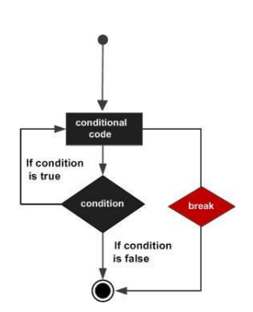
Break statements
Syntax
The syntax for a break statement in C is as follows:
break;
The break statement is almost always used with if...else statement inside the loop

Slide 61
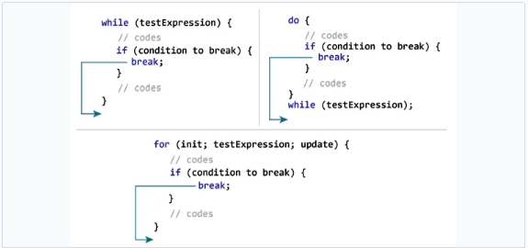
Break statements
How break statements works ?

Slide 62
Break statements example
#include <stdio.h>
int main()
{
int i;
double number, sum = 0.0;
for (i = 1; i <= 5; ++i)
{
printf("Enter n%d: ", i);
scanf("%lf", &number);
if (number < 0.0)
{
break;
}
sum += number; // sum = sum + number;
}
printf("Sum = %.2lf", sum);
return 0;
}
What is the output ?

Slide 63
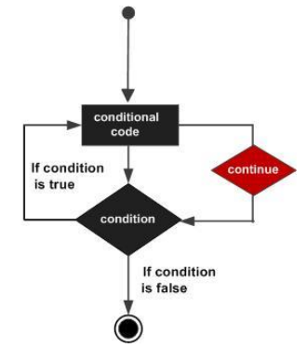
Continue statements
The continue statement skips the current iteration of the loop and continues with the next iteration.
Its syntax is:
continue;

Slide 64
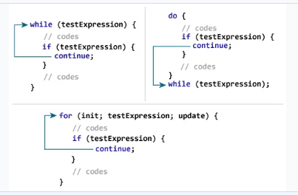
Continue statements
How continue statements works ?

Slide 65
Continue statements example
{
int i;
double number, sum = 0.0;
for (i = 1; i <= 10; ++i)
{
printf("Enter a n%d: ", i);
scanf("%lf", &number);
if (number < 0.0)
{
continue;
}
sum += number; // sum = sum + number;
}
printf("Sum = %.2lf", sum);
return 0;
}
What is the output ?

Slide 66
Continue statements example
{
int i;
double number, sum = 0.0;
for (i = 1; i <= 10; ++i)
{
printf("Enter a n%d: ", i);
scanf("%lf", &number);
if (number < 0.0)
{
continue;
}
sum += number; // sum = sum + number;
}
printf("Sum = %.2lf", sum);
return 0;
}
In this program, when the user enters a positive number, the sum is calculated using sum += number; statement.
When the user enters a negative number, the continue statement is executed and it skips the negative number from the calculation.

Slide 67
Continue statements example
#include <stdio.h>
int main ()
{
int a = 10; /* local variable definition */
do /* do loop execution */
{
if( a == 15)
{
a = a + 1; /* skip the iteration */
continue;
}
printf("value of a: %d\n", a);
a++;
}
while( a < 20 );
return 0;
}
What is the output ?

Slide 68
Goto statements
goto statement in C programming provides an unconditional jump from the 'goto' to a labeled statement in the same function.
NOTE − Use of goto statement is highly discouraged in any programming language because it makes difficult to trace the control flow of a program, making the program hard to understand and hard to modify. Any program that uses a goto can be rewritten to avoid them.
Syntax
The syntax for a goto statement in C is as follows :
goto label;
... .. ...
... .. ...
label:
statement;

Slide 69
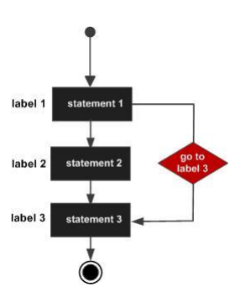
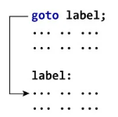
Goto statements
The label is an identifier. When the goto statement is encountered, the control of the program jumps to label: and starts executing the code.
Here label can be any plain text except C keyword and it can be set anywhere in the C program above or below to goto statement.

Slide 70
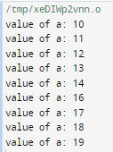
Goto statements example
#include <stdio.h>
int main ()
{
int a = 10; /* local variable definition */
LOOP: do /* do loop execution */
{
if( a == 15)
{
a = a + 1; /* skip the iteration */
goto LOOP;
}
printf("value of a: %d\n", a);
a++;
}
while( a < 20 );
return 0;
}

Slide 71
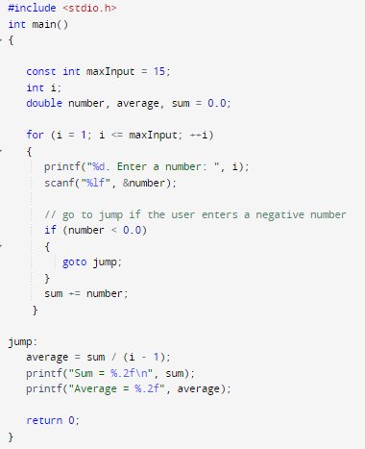
Goto statements example
What is the output ?

